Slide 1
Improved Methods for Automated Corn Leaf Disease Recognition
Abu Zahed
221-15-4716
Department of CSE
Daffodil International University
Mr. Mayen Uddin Mojumdar
Sr. Lecturer
Department Of CSE
Daffodil International University

Slide 2
Outline
Introduction
Problem Statement
Motivation and Objective
Related Works
Comparison Between Existing Works
Gap Analysis
Proposed Methodology
Q & A

Slide 3
Introduction
Corn is an important crop worldwide and in Bangladesh, providing food, animal feed, and biofuel. However, diseases like Corn Leaf Blight, Common Rust, and Gray Leaf Spot often damage leaves, lowering crop yield and quality.
Traditional disease detection relies on farmers or experts visually checking the leaves, which is slow, subjective, and often inaccurate, especially in real field conditions.
Recent research shows that Deep Learning, especially Convolutional Neural Networks (CNNs), can detect plant diseases from images with high accuracy. But many existing models are large, need powerful computers, and are not practical for use in rural farming areas without stable internet.
This research develops a lightweight CNN model for detecting six types of corn leaf diseases from a custom, field-collected dataset in Bangladesh. The dataset was preprocessed using resizing, denoising, and normalization, and balanced using data augmentation.
The final model is deployed in a TensorFlow Lite + Flutter mobile application, enabling offline, real-time diagnosis directly in the field. This work improves disease detection accessibility, model efficiency, and supports sustainable agriculture through early diagnosis and better crop management.

Slide 4
Problem Statement
High Crop Losses – Corn leaf diseases like Northern Corn Leaf Blight, Common Rust, and Gray Leaf Spot cause severe yield and quality reduction.
Limitations of Manual Inspection – Visual diagnosis by farmers is slow, subjective, and error-prone, especially under varying field conditions.
Lack of Accessible AI Solutions – Many deep learning models are too large and require high-end hardware, making them unsuitable for rural and real-time use.
Limited Multi-Disease Capability – Few lightweight systems can accurately detect and classify multiple corn leaf diseases from field images.
Data Imbalance Issues – Real-world datasets often have unequal class distributions, reducing accuracy and generalization.
Deployment Challenges – Existing solutions are rarely optimized for offline, low-resource environments like rural farms.

Slide 5
Motivation and Objective
Motivation | Objectives
Maize is a key food, feed, and biofuel crop worldwide, crucial for rural livelihoods and national economies. | Develop an AI-based system to detect and classify multiple maize leaf diseases accurately.
Leaf diseases cause significant yield losses and threaten food security. | Ensure the system works in real field conditions with complex backgrounds and varying lighting.
Farmers often lack quick and accurate tools to identify diseases in early stages. | Use deep learning models (e.g., CNN, DenseNet, MobileNet) for automated disease recognition.
Advances in AI and Deep Learning make it possible to detect diseases automatically from leaf images. | Provide farmers with a fast, reliable, and user-friendly tool for early intervention.
An intelligent detection system can save time, reduce costs, and prevent large-scale crop damage. | Contribute to sustainable agriculture and improved food security.

Slide 6
Related Works
Fraiwan et al. (2022) – Applied transfer learning using AlexNet, VGG16, and ResNet50 for corn disease classification, but limited to lab images without real-world field noise.
Li et al. (2023) – Proposed MDCDenseNet (DenseNet121 + CBAM + multi-dilated convolutions), but required high computational resources and had a small sample size.
Pan et al. (2023) – Used GoogleNet with ArcFace and A-Softmax for Northern Corn Leaf Blight, but addressed only a single disease class.
Khan et al. (2023) – Developed YOLOv8n-based mobile detection system for multiple corn diseases, but had high computational demand for mobile deployment.
Mohanty et al. (2023) – Combined ResNet50-GAP with VGG19, but the large ensemble size limited its suitability for lightweight, real-time applications.

Slide 7
Comparison Between Existing Works
Author(s) | Model(s) Used | Limitation(s)
Fraiwan et al. (2022) | Transfer Learning (AlexNet, VGG16, ResNet50) | Lab images only, no field noise
Li et al. (2023) | MDCDenseNet (DenseNet121 + CBAM + multi-dilated conv.) | Small dataset, high parameters
Pan et al. (2023) | GoogleNet + ArcFace / A-Softmax | Single-disease dataset
Khan et al. (2023) | YOLOv8n mobile detector | Requires high computation & bandwidth
Mohanty et al. (2023) | ResNet50-GAP + VGG19 fusion | Large ensemble size
Gopalan et al. (2025) | ResNet152 + Grad-CAM | Heavy backbone, high computation
Bi et al. (2023) | MobileNetV3-ECA (dilated) | Same-source data only

Slide 8
Gap Analysis
Large Model Sizes – Many high-performing CNN models (DenseNet, ResNet152, large ensembles) are too heavy for efficient mobile or edge deployment.
Lack of Real-Time Mobile Solutions – Few existing systems are optimized for offline, real-time corn leaf disease detection in rural farming areas.
Multi-Disease Limitation – Several works focus on a single disease, limiting their usefulness for detecting multiple corn leaf diseases.
Class Imbalance Issues – Many datasets suffer from unequal class distribution, reducing accuracy for minority disease classes.
Limited Field Testing – Few models are validated with real field images under varying lighting, occlusion, and background conditions in Bangladesh.

Slide 9
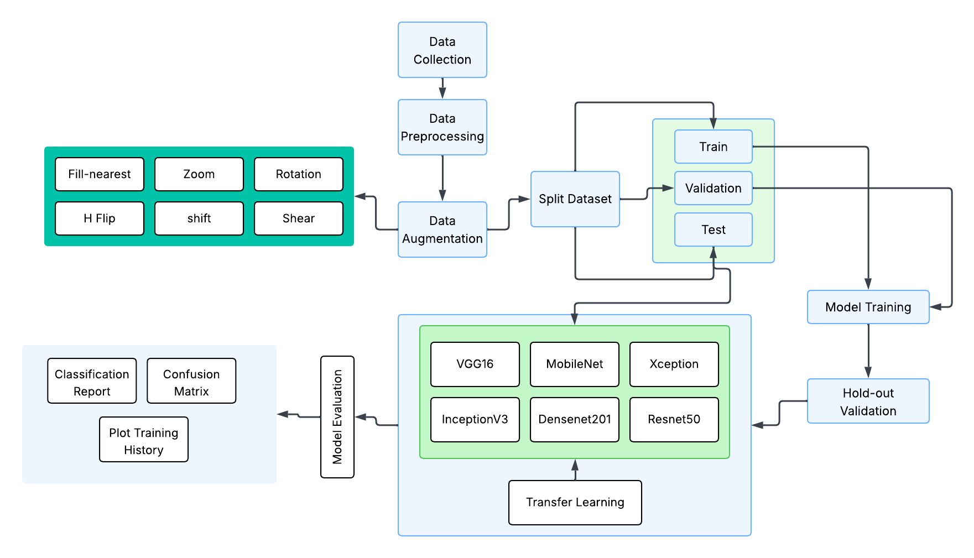
Proposed Methodology

Slide 10
THANK YOU

